Slide 1
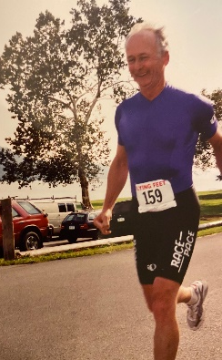
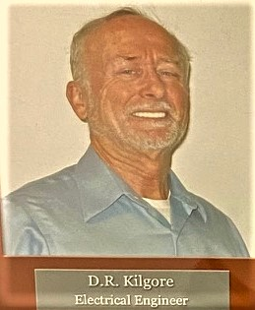
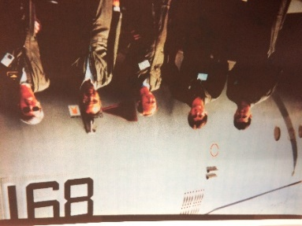
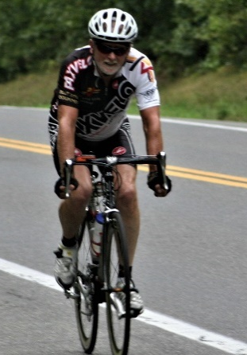
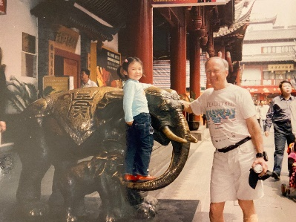
TACAMO Hall of Fame - 2019
Roger Kilgore – Industry Partner
Service- All TACAMO
-Sonic Sciences Inc-76-81 / Electrospace Systems Inc- 82-83
-GRD Inc 83-90 / MITRE 92-96
-GRD 96-2007 / SAIC 2007-2019
-Sabre Systems 2020
Contributions -44 Years all TACAMO- TAC IV to HPTS
THE Very Low Frequency Expert since joining TACAMO in 76- measured signals, studied modes during testing, and applied that knowledge to increase receive and transmit success
Continuous technical lead in all things radio frequency (RF)- solved UHF SATCOM and A/G issues
Directed a number of classified improvements for TACAMO uplink and downlink transmissions
Also conducted studies of land-based submarine VLF systems leading to greater effectiveness
Technical lead on Herc and Merc VLF transmit systems, old and new, and new receivers
Conceptualized time source solutions to decades old issues
Created VLF basics and advanced overview presentations for DoD, USAF, Navy leaders
Leadership
-Self starter on ways to improve systems-continuous systems improvement
-Mentor to leadership for over 40 years
-Spokesman in NC3 meetings with DoD, JS, STRAT, USAF
-Stepped in to help USAF resolve bomber/missile VLF issues
Community Service
–As an athlete, organized and led events as well as competed
-President of the Westminster Road Runners Club - 13 years
-Led the PaxVelo Bicycle club Tuesday Night Ride for 7 years
Peer recognition-
-Leading engineers MITRE + Applied Physics Lab
-Submarine comms engineers and managers
-NAVAIR, Wing, Joint Staff, DoD and TCVA

